Slide 1
伊朗高科技产品
部分伊朗高科技产品介绍

Slide 2
医疗设备

Slide 3
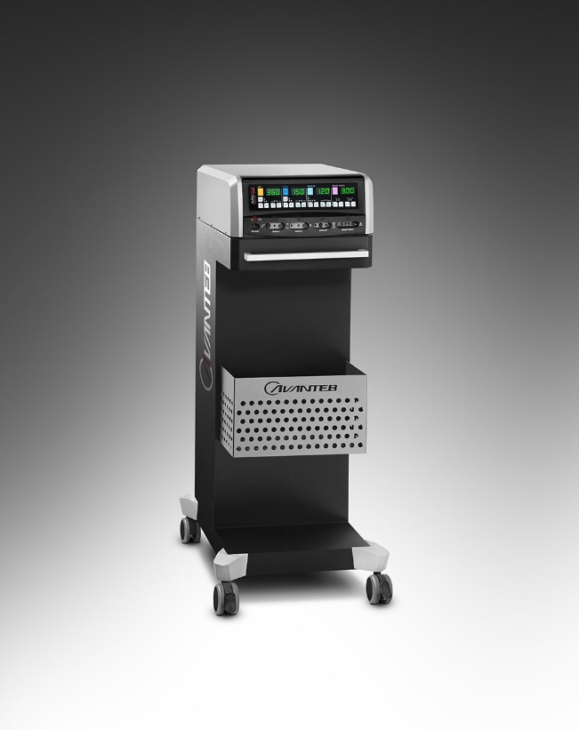

Production capacity
100 Units (Per month)
智能电外科
After sale services/ Guarantee
4 year Guarantee
10 year after sale services
Input Voltage: 190∼245 VAC
Input Frequency: 50∼60 Hz
Max Supply Current: 3.8 A
Main Fuses: 2×4 AT
Weight: 10 Kg
Dimensions: 40×48×16 Cm
Accordance with IEC601-1(2005), IEC601-2-2(2006)
Type of Output: CF
HF Leakage Current: Monopolar<100 mA,
Single Fault Condition<50 μA
Protection Class: I
Sink Current<500 μA
Standards and legally certificates:
ISO9001 2008 (BRS)
ISO13485 2003 (BRS)
Iran ministry of health
Sales’ Price
3500$-5500$

Slide 4
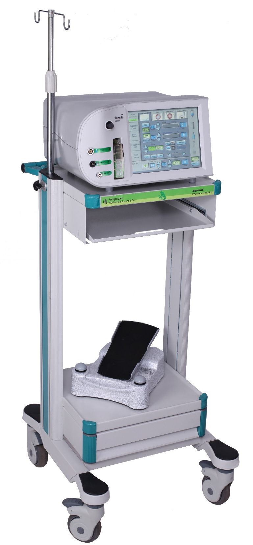

Production Capacity
Eye Surgery
Phaco-Vitrectomy Anterior (Morvarid Dual)
Phaco Anterior Vitrectomy machine with dual pump,Peristaltic & Venturi pump
Control pressuring bottle serum by BAP (Bottle Air Pressure) set
Phaco control in continuous , Pulse , Cool phaco and Burst mode
Safe Vacuum with peristaltic pump up to 60cc/min
High vacuum in venture pump up to 500mmHg
40KHz Phaco handpiece
Dual linear foot pedal multi function
Anterior vitrectomy up to 800 CPM
Bipolar coagulation : 7.5W
User friendly ,User Interface
After sale services/ Guarantee
5 years main unit
Standards and legally certificates:
ISO 13485
CE 2195

Slide 5
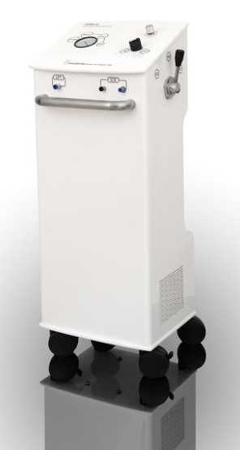
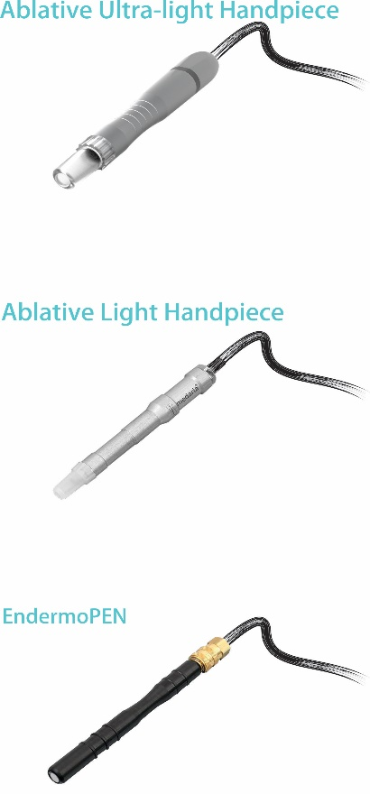

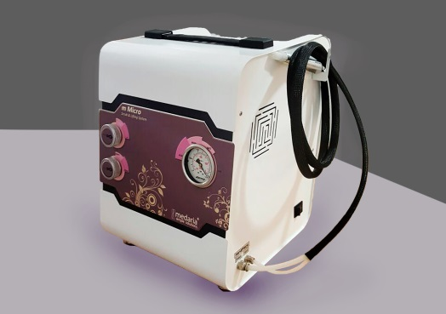
Production capacity
50 systems (Per month)
mMicro
After sale services/ Guarantee
120 months after sale services
12 months Guarantee
Microdermabration:
combination of microdermabration & endermololift system, 100% natural treatment of rejuvenation , lifting, curing acne, pigmentation, scrub eyelids
Two Models:
Stand Model
Portable Model
Two types of treatment:
Ablative Ultra-Light pen
EndermoPEN (mini cup)
Standards and legally certificates:
ISO 9001 , ISO 13485
CE pending
Production License from MOH
Sales’ Price
2,080.00 USD

Slide 6
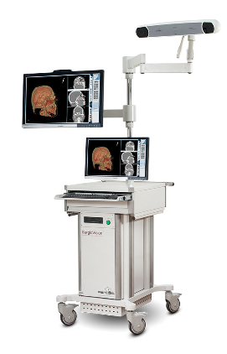

Production capacity
10 Device (Per month)
OpticVisionTM (OV3)
After sale services/ Guarantee
120 months after sale services
12 months Guarantee
High precise and reliable navigation system
Advanced, user friendly and robust software
Highly maneuverable flexible arms
wide and easy to use monitors
Variety of functionally designed instrument
Supporting a Wide range of image types
Applicable in Neurosurgery, Spine and Maxillofacial surgeries
Full integration with conventional operation room devices
Standards and legally certificates:
CE
IEC60601-1-4 , IEC60601-1-1
IEC60601-1-2 , ISO9001-2008
Sales’ Price
115,000 $ - 155,000 $ (Depending on The Options)

Slide 7
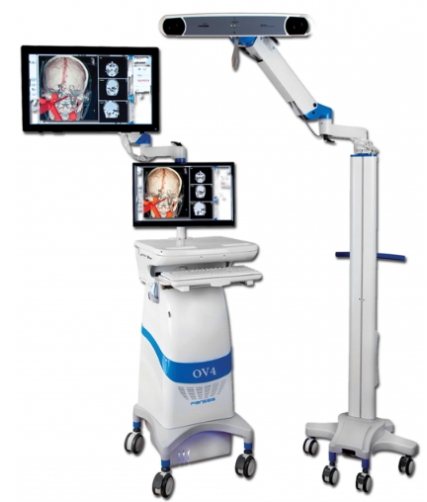
Production capacity
10 Devices (Per month)
OpticVisionTM (OV4)
After sale services/ Guarantee
120 months after sale services
12 months Guarantee
Various Software Features
Extended field of view (3000 mm, 1470 mm, 1856 mm
High precision tracking system with 0.25 mm RMS accuracy
Advanced visualization engine
Highly maneuverable thanks to its separated trolleys
Touch screen surgeon monitor
Customized surgery tools for left or right-handed surgeon
Specific guided frame less biopsy
Import and visualize high quality Endoscope/Microscope video
Standards and legally certificates:
CE is in progress
Iran ministry of health
Sales’ Price
130,000 $ - 170,000$ (Depending on The Options)

Slide 8
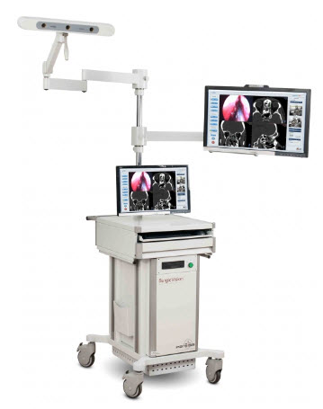
Production capacity
10 Device (Per month)
ImageVisionTM
After sale services/ Guarantee
120 months after sale services
12 months Guarantee
Unique multi-face tool to eliminate line of sight problem
Specific tool design to access all sinuses
Tracking device with extensive field of view
Review of surgery procedure via auto saved module
Extensive operational area coverage with two long articulated arms
General adaptors to define selected surgery tools as a navigation probe
Standards and legally certificates:
CE
IEC60601-1-4 , IEC60601-1-1
IEC60601-1-2 , ISO9001-2008
Sales’ Price
105,000 $ - 145,000 $ (Depending on The Options)

Slide 9
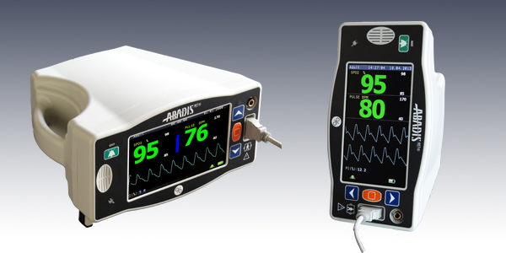

Production capacity
2000 Devices (Per month)
ABADIS907 (Digital Pulseoximeter)
After sale services/ Guarantee
120 months after sale services
12 months Guarantee
Measuring:
Oxygen Saturation (SpO2)
Pulse Rate (PR) & Temperature
Plethysmograph Waveform
Perfusion Index (PI)
High Accuracy and Precision of Parameters on Low Perfusion Condition
Internal Rechargeable Battery with 6 Hours Working Capacity
ETHERNET Connector Complying HL7 Protocols
USB Connector
Arm Processor Design
Unlimited Trend for Several Patients
7 Inch Full Color TFT LCD
Standards and legally certificates:
ASTM F2761-09
ISO 80601-2-61 , 80601-1-8
ISO 14971 , ISO 60601-1
Sales’ Price
960 $

Slide 10
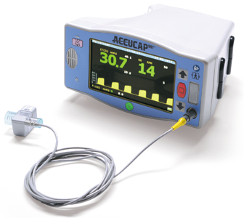
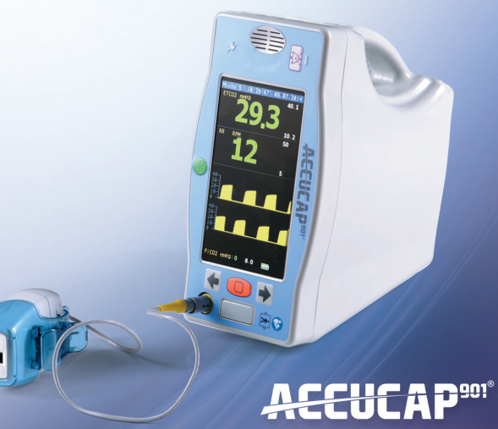
Production capacity
2000 Devices (Per month)
ACCUCAP901
After sale services/ Guarantee
Mainstream / Microstream Capnography Monitoring
Continues Monitoring of EtCO2, Respiration Rate and FiCO2
Real Time CO2 Waveform
High Accuracy and Stability
Internal Rechargeable Battery with 5 Hours Working Capacity
ETHERNET Connection Complying HL7 Protocols
USB Connector
Unlimited Trend for Several Patients
7 inch TFT LCD with CAPACITIVE TOUCH panel
Capability to Install other Vital Sign Modules
120 months after sale services
12 months Guarantee
Standards and legally certificates:
ASTM F2761-09
ISO 80601-2-61 , ISO 80601-2-55 ISO 14971 , ISO 60601-1
Sales’ Price
1620 $

Slide 11

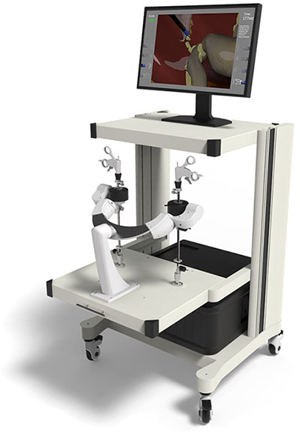
Production capacity
10 Units (Per month)
SinaSim
After sale services/ Guarantee
120 months after sale services
12 months Guarantee
A Virtual-Reality-Based system
Combination of computer hardware and software modules which recreate the procedures and environment of abdominal keyhole surgery
Safe and effective learning experience
Advantages:
Essential Training Tasks
Advance Surgery Simulation
Realistic Graphics/Real-time Physics
Performance Tracking
Standards and legally certificates:
Local (Iran) Certificates
Sales’ Price
20000 $ (for distributers)

Slide 12

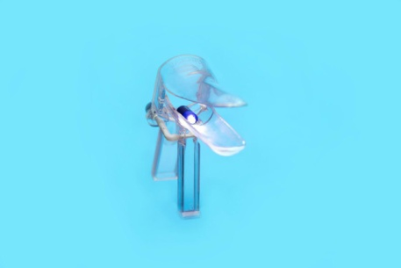
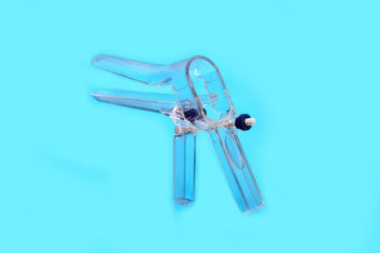
Production capacity
1000 Packages (Per Month)
Disposable Speculum
Equipped with direct light and also anti-spasm and anti-pain designs. Lack of any extra additional part which prevents any scratch and damage to vagina wall;
Generate a highly transparency due to the company’s utilization of first rank and high quality materials;
Reduce pain due to the balanced gradient of above part;
Microscopic from, which can facilitates the detection of cervix diseases and damages for physician;
About 5g heavier than market similar products in order to strength its body structure.
After sale services/ Guarantee
All components of the products are successfully tested
Standards and legally certificates:
Local (Iran) Certificates
Sales’ Price
0.28 USD

Slide 13
Laboratory Devices

Slide 14

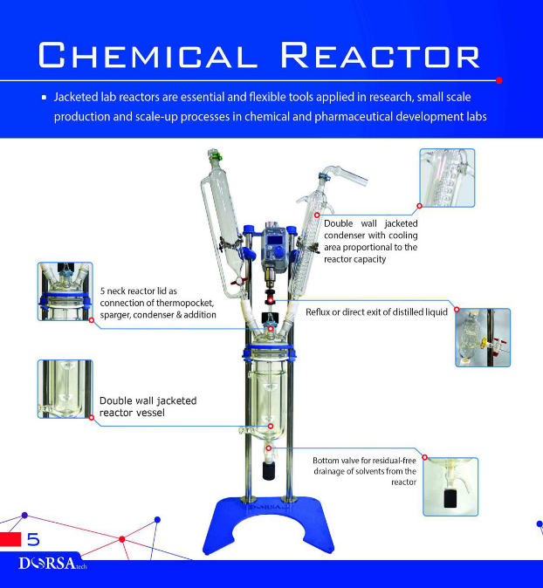
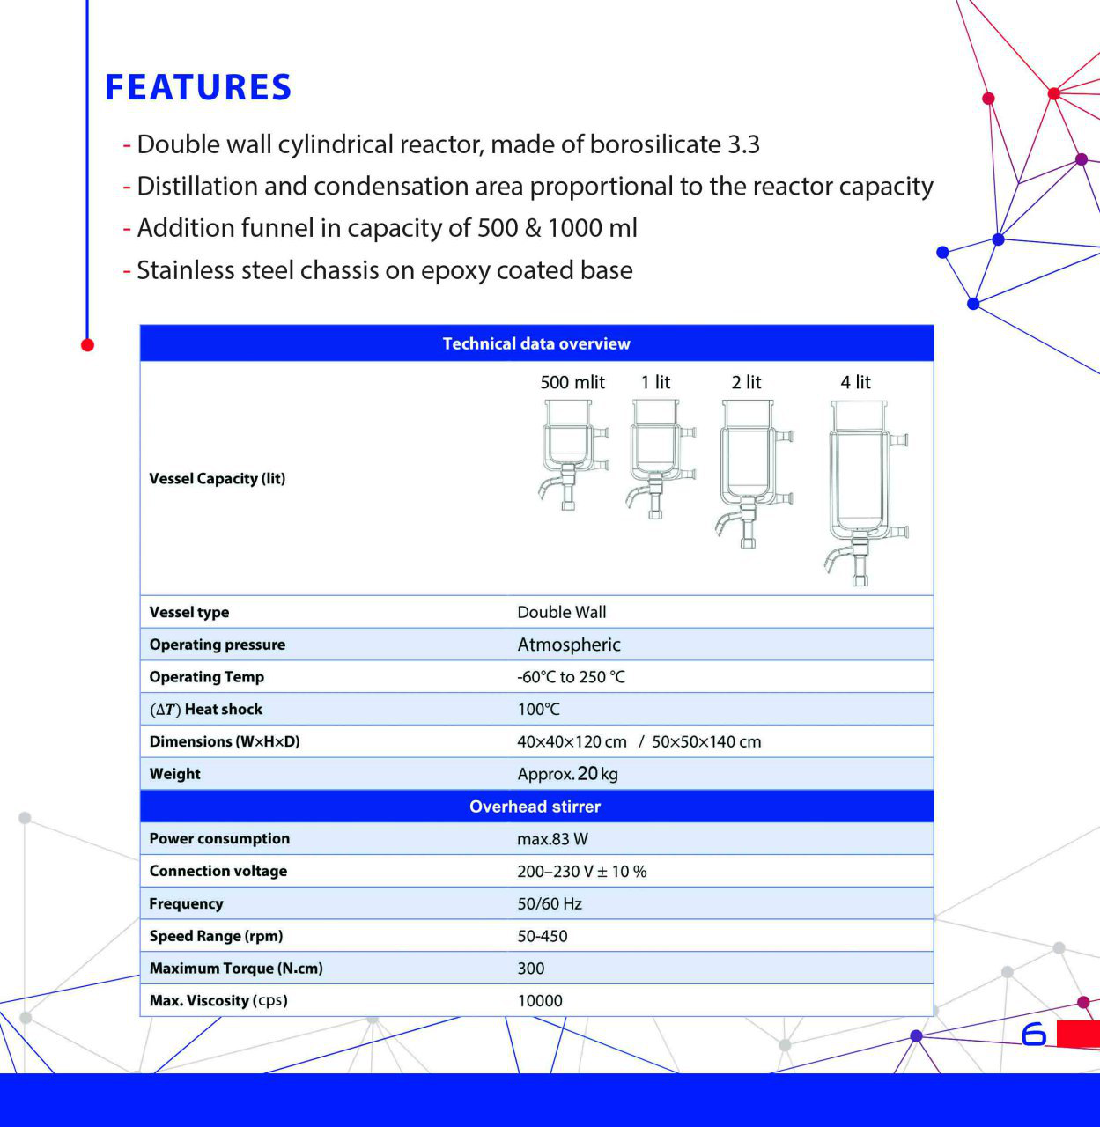
Production capacity
20 products (Per month)
After sale services/ Guarantee
60 months after sale services
12 months Guarantee
Standards and legally certificates:
???
Sales’ Price
4000 $

Slide 15
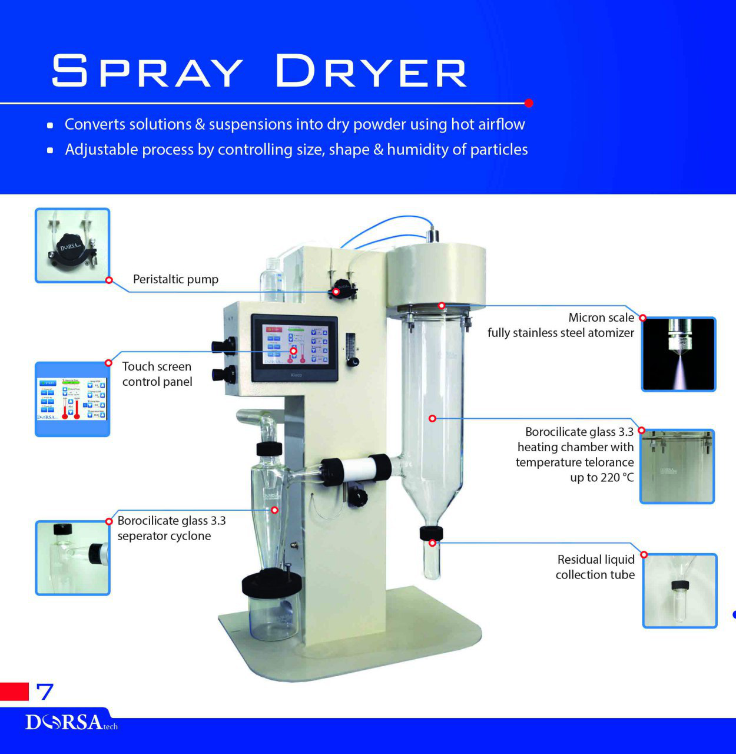
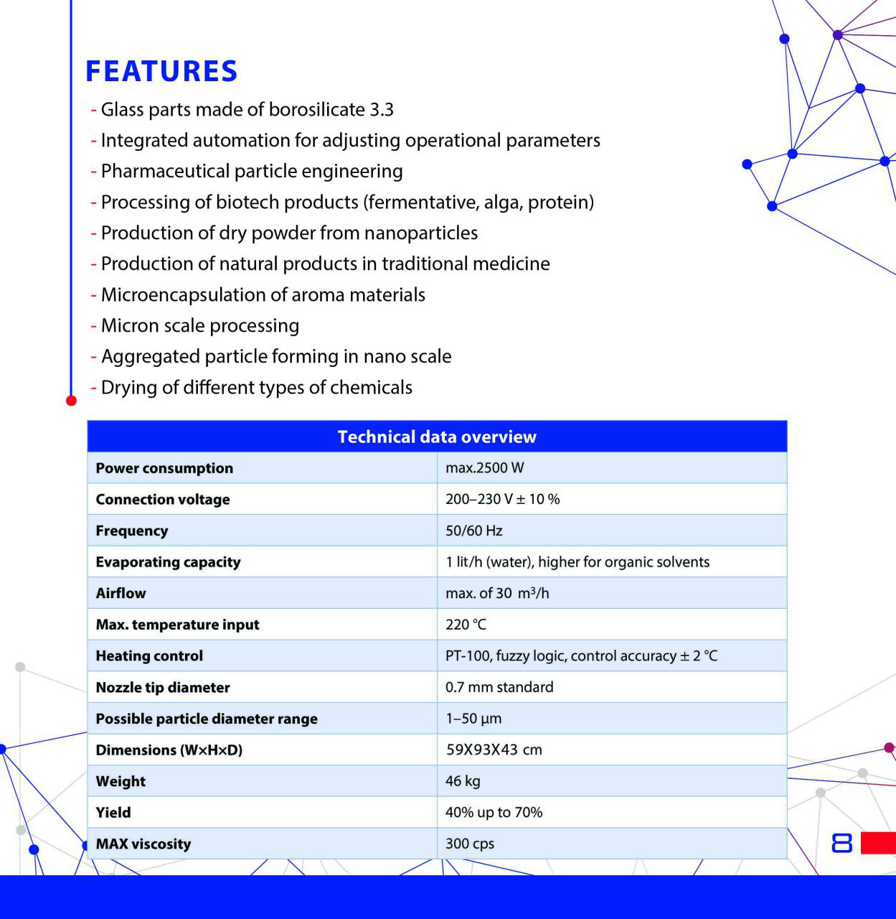
Production capacity
20 products (Per month)
After sale services/ Guarantee
60 months after sale services
12 months Guarantee
Standards and legally certificates:
???
Sales’ Price
13300 $

Slide 16

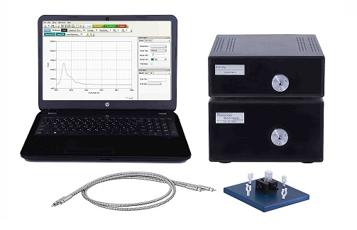
Production capacity
50 Products (Per Year)
Fluorescence Spectrometer
After sale services/ Guarantee
120 months after sale services
12 months Guarantee
Simultaneous obtained of all spectra
Integration time controlling using software
Mathematical processing (Averaging, Sum, Smooth, …..)
Time Monitoring of spectra
Wavelength range: 380-800 nm
Light source : Deuterium / Halogen - Tungsten Lamp
Standards and legally certificates:
ISO
CE
Sales’ Price
19000 USD

Slide 17
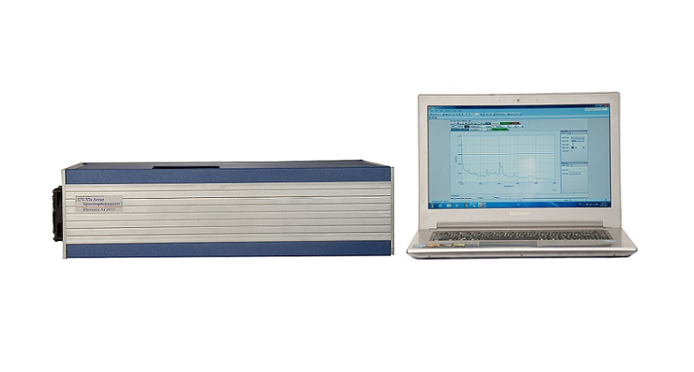
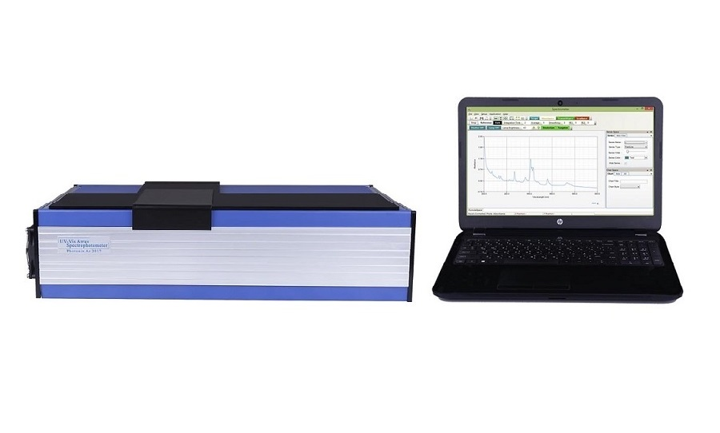
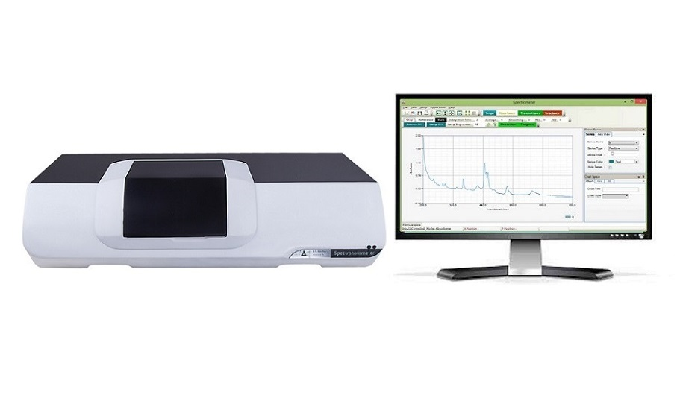
Production capacity
100 Products (Per Year)
UV-Vis Array Spectrophotometer
After sale services/ Guarantee
120 months after sale services
12 months Guarantee
Simultaneous obtained of all spectra
Integration time controlling using software
Lamp intensity controlling using software
Mathematical processing (Averaging, Sum, Smooth, …)
Standard Wavelength calibration of spectrophotometer
Wavelength range:200-800 nm
Resolution :< + 1.0 nm
Light source : Deuterium + Tungsten lamp
Detector : 2000 Multichannel
Standards and legally certificates:
ISO
CE
Sales’ Price
17000, 19100, 21000 USD

Slide 18
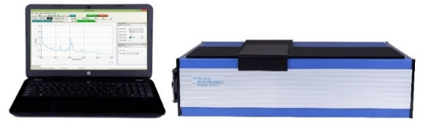
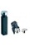
Production capacity
50 Products (Per Year)
Nanodrop Spectrophotometer
After sale services/ Guarantee
120 months after sale services
12 months Guarantee
Micro Volume Analysis in nanolitre range
Simultaneous obtained of all spectra
Integration time controlling using software
Lamp intensity controlling using software
Mathematical processing (Averaging, Sum, Smooth, …)
Standard Wavelength calibration of spectrophotometer
Wavelength range:200-800 nm
Resolution :< + 1.0 nm
Light source : Deuterium + Tungsten lamp
Detector : 2000 Multichannel
Standards and legally certificates:
ISO
CE
Sales’ Price
21000 USD

Slide 19
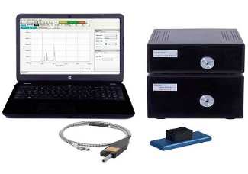
Production capacity
50 Products (Per Year)
Raman Spectrometer
After sale services/ Guarantee
120 months after sale services
12 months Guarantee
Simultaneous obtained of all spectra
Integration time controlling using software
Mathematical processing (Averaging, Sum, Smooth, …..)
Time Monitoring of spectra
Wavelength range: 150- 4500 cm-1
Resolution : < + 20 cm-1
Light source : Laser 532 nm , 633 nm
Standards and legally certificates:
ISO
CE
Sales’ Price
28000 USD

Slide 20
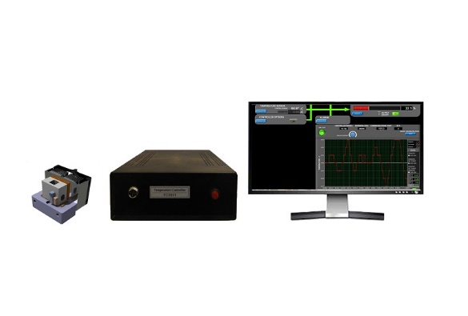
Production capacity
50 Products (Per Year)
Color Measurment Spectrophotometer
After sale services/ Guarantee
120 months after sale services
12 months Guarantee
Capable of automatically reversing power to Peltier thermoelectric (TE) devices to provide heating or cooling as required to maintain a specific set point temperature Peltier system for Temperature controlling of Spectrophotometer Cell.
Temperature range: 5 - 85°C
Temperature accuracy: ± 0.5°C
Temperature resolution: 0.3 °C
Upward tendency proportion: < ± 0.1°C / sec
Power :200-240 VAC , 50 - 60 HZ
Standards and legally certificates:
ISO
CE
Sales’ Price
??? USD

Slide 21

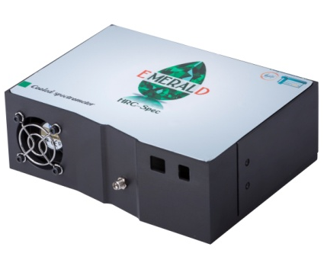
Production capacity
10 Devices (Per Year)
TakNegar optical Spectrometer
After sale services/ Guarantee
120 months after sale services
12 months Guarantee
Spectral Resolution (cm-1): 10
Spectral Range (cm-1): 150 - 4600
Light characterization
Safety, Security & Forensics
Art & Archaeology
Semiconductor
Gems & Minerals
Plastics & Polymers
Medical & Biomedical Diagnostics
Teaching & Education
Food & Feed
Nanotech
Petroleum & Petrochem
Pharmaceutical, Nutriceutical & Cosmetics
Standards and legally certificates:
???
Sales’ Price
8000 $

Slide 22
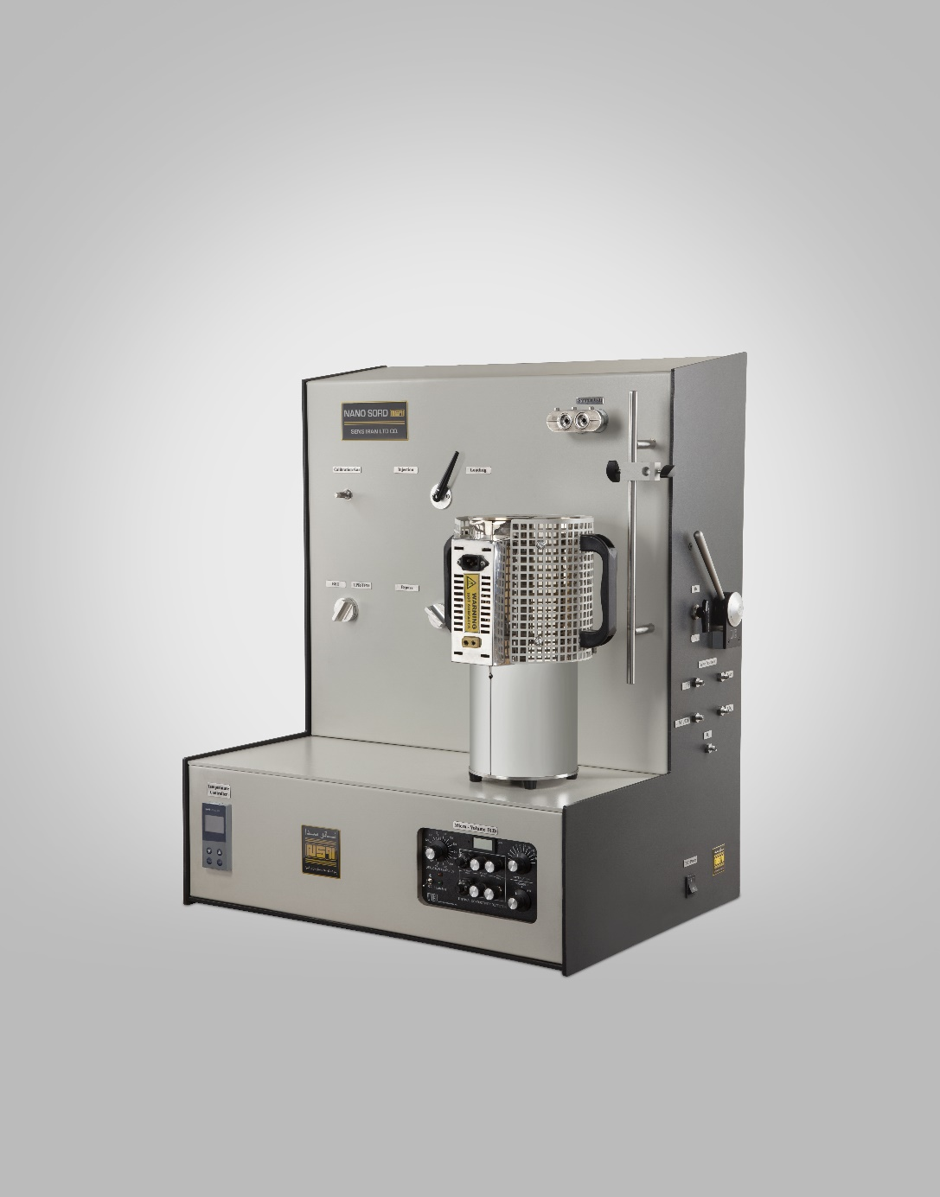

Production capacity
SENSIRAN
4 Devices (Per year)
Towse-e Hesgarsazan-e Asia
NanoSORD
After sale services/ Guarantee
Characterization of Nano-Structured Materials Such as:
Metal Nanoparticles
Metal Oxide and Sulfide
Carbon nanotubes
Nanofibers
Nano-adsorbents
…
Determining Properties of Materials Including:
The BET Specific Surface Area
Metal Dispersion
The Adsorption Properties of Nanoparticles
Temperature
Mechanism of Reduction for Nano-Metal Oxide
120 months after sale services
12 months Guarantee
Standards and legally certificates:
???
Sales’ Price
60000 $

Slide 23
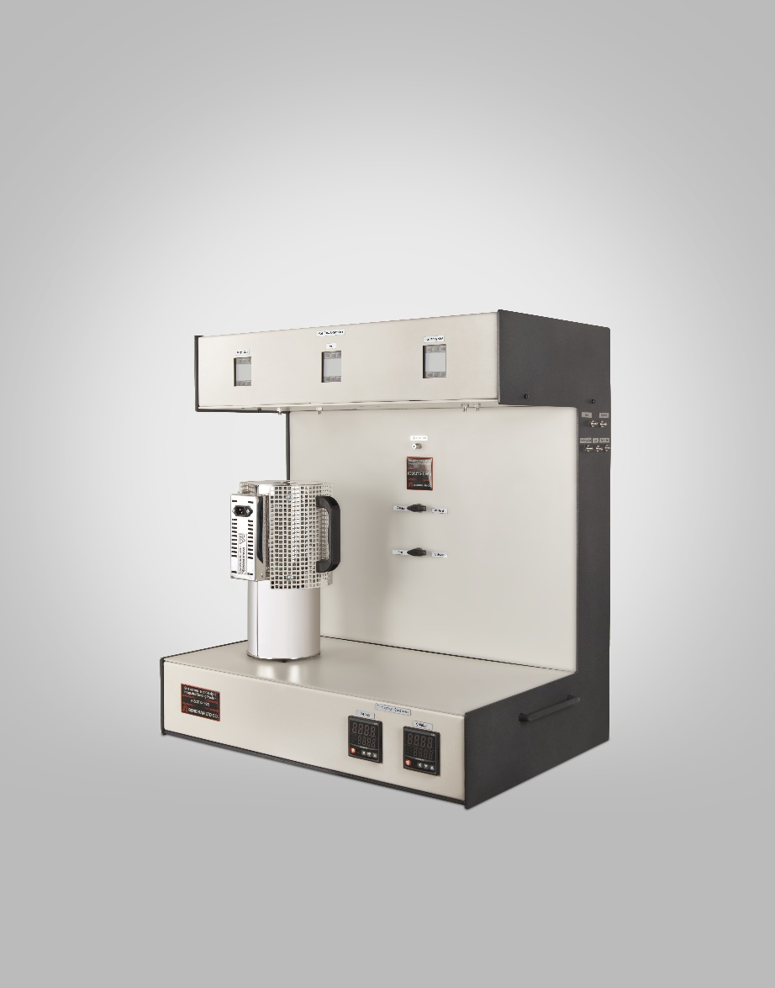
Production capacity
SENSIRAN
4 Devices (Per year)
Towse-e Hesgarsazan-e Asia
GSCITS
After sale services/ Guarantee
120 months after sale services
12 months Guarantee
Designed and built by integration of two devices: Catatest and Gas Sensor Testing System.
It is used in for research and development of semiconductor-based gas sensors as well as for testing the catalytic performance of materials.
Standards and legally certificates:
???
Sales’ Price
40000 $

Slide 24

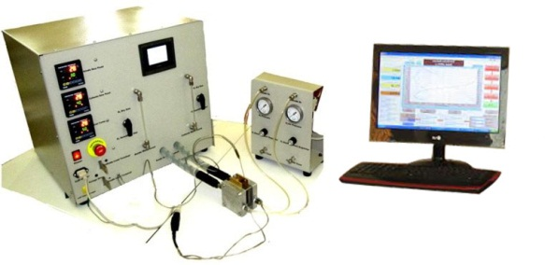
Production capacity
5 Devices (Per month)
Fuel Cell Test Station
Maximum Load Current 12/ 80 A
Maximum Load Power: 125 W
Maximum Whole Cell Voltage: 20 V
Voltage Accuracy: ±3 mV±3% of reading
Reactant Gas Control System: All 316 SS construction (humidifiers, flow path, valves and MFC) with Swagelok fittings
Mass Flow Control: Anode 2 SLPM and Cathode 5 SLPM
Dual rate software controlled mass flow controllers
Automatic N2 purge
Back pressure Control: Standard: Manual control, 0-30 PSIG
Temperature Controllers: cell, anode humidifier, cathode humidifier
Suitable for PEMFC, SOFC, DAFC and AFC evaluation
After sale services/ Guarantee
120 months after sale services
12 months Guarantee
Standards and legally certificates:
???
Sales’ Price
27000 $

Slide 25
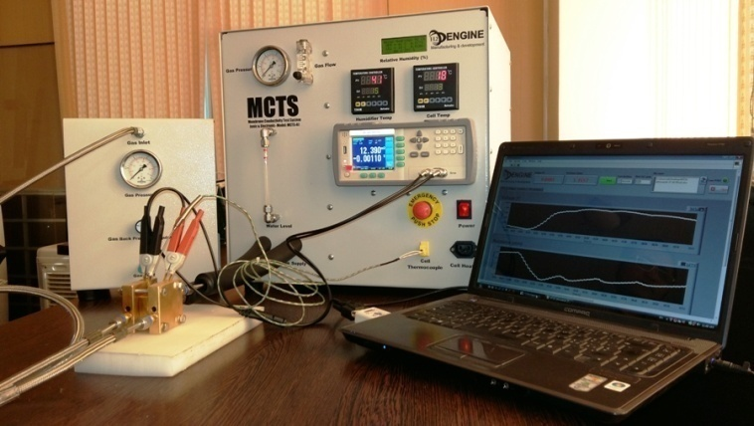
Production capacity
5 Devices (Per month)
Ionic and Electronic Conductivity Test System
After sale services/ Guarantee
120 months after sale services
12 months Guarantee
Measure and Record The Resistance of Different Materials as A Function of Temperature, Humidity and Pressure at Different media (Acidic, Alkaline or Salty).
Resistance measurement range: 30mΩ to 30kΩ
Voltage measurement range: 12 V to 120 V
Resistance accuracy: 0.001 mΩ
Voltage accuracy: 0.00001 V
Maximum temperature: 200 oC for conductivity cell and 120 oC for humidifier (at 2 bar)
Computer controlled operation using professional software
Stainless steel line and fittings
Standards and legally certificates:
???
Sales’ Price
18500 $

Slide 26
Biotech Products

Slide 27

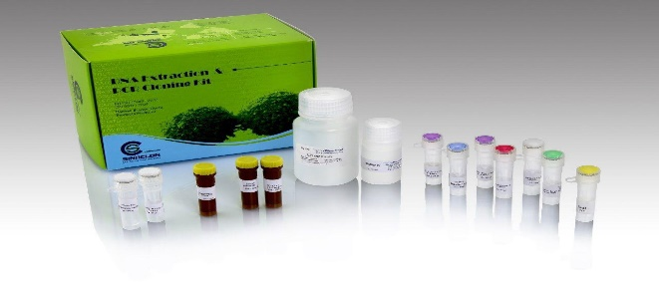
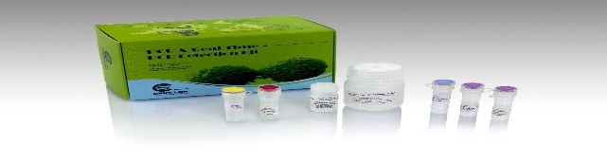
Production capacity
500 Kits (Per month for each type of Kit)
Detection Kits
After sale services/ Guarantee
All components of the Kits are successfully tested in the DNA purification and amplification reaction
Extraction and Purification KIT
Taq DNA Polymerase
PCR Detection KIT
PCR Cloning KIT
PCR & Real Time PCR Master Mix
Protein Marker & DNA Ladder
FastDigest Enzymes
Standards and legally certificates:
ISO 13485
ISO 9001
Sales’ Price
42 – 199 USD (Depends on different type of Kits(

Slide 28
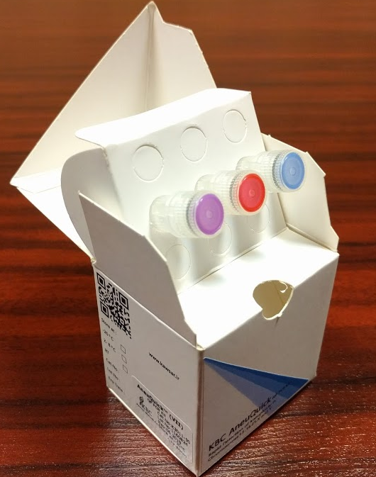

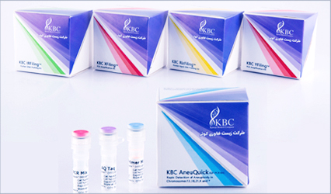
Production capacity
1000 Kits (Per month)
AneuQuick™ kit (IVD)
After sale services/ Guarantee
All components of the Kits are successfully tested
The first homemade product for molecular genetic diagnosis of Aneuploidies
Lower price in comparison with the same other products while the results have the same quality
IVD certification approved
Rapid Detection of Numerical Aneuploidies ( molecular Genetics) of Chromosomes 21, 18, 13, X and Y (QF-PCR)
Standards and legally certificates:
ISO 13485
ISO 9001
Sales’ Price
1000 USD

Slide 29

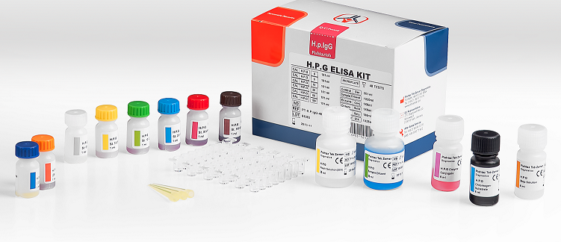
Production capacity
2500 Kits (Per Month)
Infectious Disease
After sale services/ Guarantee
All components of the Kits are successfully tested
Dengue
Syphilis
Fasciola Hepatica IgG
H.pylori IgG
H.pylori IgA
H.pylori IgM
Hydatid Cyst (Echinococcus IgG)
Brucella IgG
Brucella IgM
Standards and legally certificates:
Local (Iran) Certificates
Sales’ Price
49.00 USD

Slide 30
Production capacity
2500 Kits (Per Month)
TORCH Panel
After sale services/ Guarantee
All components of the Kits are successfully tested
Toxoplasma IgG
Toxoplasma IgM
Rubella IgG
Rubella IgM
CMV IgG
CMV IgM
HSV 1,2 IgG
HSV 1,2 IgM
Standards and legally certificates:
Local (Iran) Certificates
Sales’ Price
42.00 USD

Slide 31
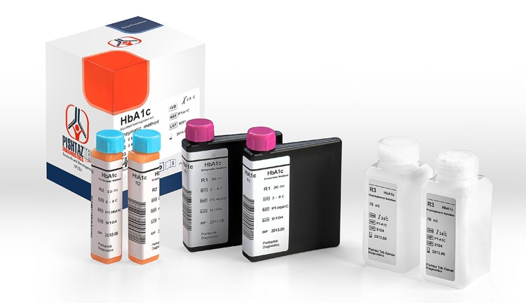
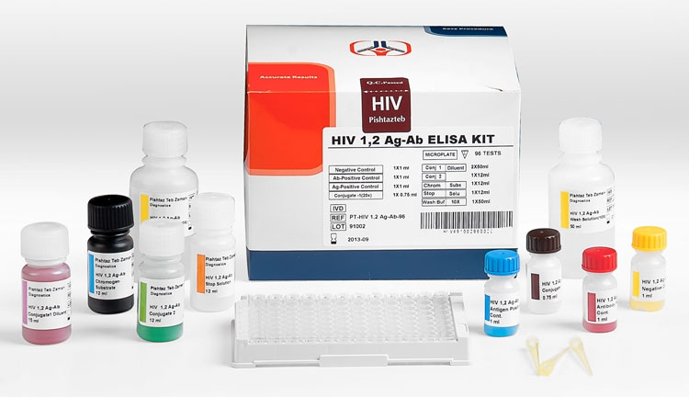
Production capacity
2500 Kits (Per Month)
Biochemistry Panel
HbA1c
HDL-C
LDL-C
TIBC
After sale services/ Guarantee
All components of the Kits are successfully tested
HIV & hepatitis Panel
Standards and legally certificates:
Local (Iran) Certificates
HIV 1,2 Ab
HIV 1,2 4th generation
HCV Ab
HBs Ab
HBs Ag
Sales’ Price
222.00 USD
65.00 USD

Slide 32
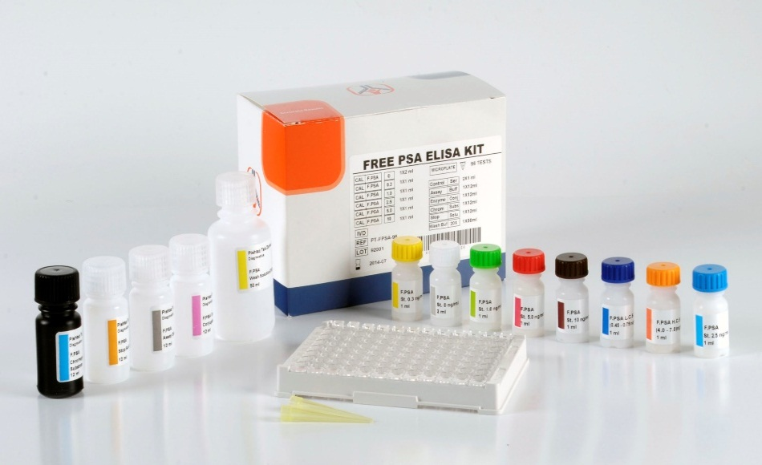
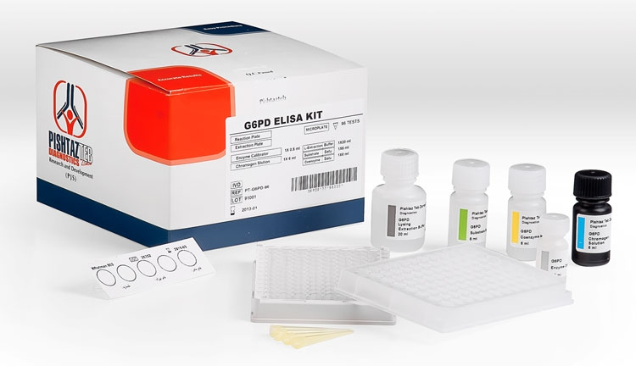
Production capacity
2500 Kits (Per Month)
Tumor Markers Panel
PSA
Free PSA
AFP
CEA
CA 19-9
CA 125
After sale services/ Guarantee
All components of the Kits are successfully tested
Standards and legally certificates:
Neonatal Screening Panel
Local (Iran) Certificates
G6PD
Neo-TSH
Neo-PKU
Neo-Galactosemia
Sales’ Price
53.00 USD

Slide 33
Drug & Healthcare Products

Slide 34

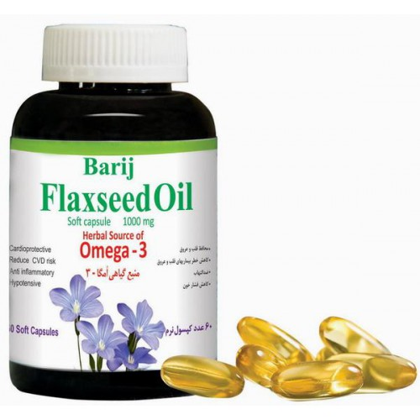
Production capacity
20000 Packages (Per 35 Days)
Flaxseed Oil Soft Capsule
After sale services/ Guarantee
Indications: Aid in cardiovascular health and reduction of coronary heart disease risk; Adjuvant treatment for reduction of blood lipids; Antioxidant
Dosage form and packaging: 60 Soft capsules - 1000 mg
Composition: Flaxseed oil (Linum usitatissimum L.)
Administration: Unless otherwise instructed by the physician, take 1 soft capsule with your meal, 3 times per day.
Not applicable
Standards and legally certificates:
Local (Iran) Certificates
Sales’ Price
7.36 USD

Slide 35
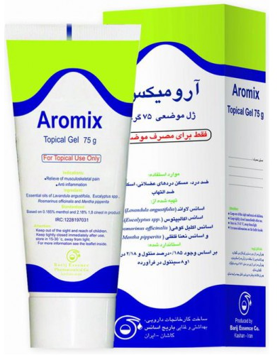
Production capacity
20000 Packages (Per 35 Days)
Aromix Topical Gel
After sale services/ Guarantee
Indications: Analgesic; Alleviation of musculoskeletal pain; Anti-inflammatory
Dosage form and packaging: Syrup - 250 ml
Composition: Essential oil of lavender (Lavandula angustifolia); Essential oil of eucalyptus (Ecalyptus spp.); Essential oil of rosemary (Rosmarinus officinalis); Essential oil of peppermint (Mentha pipperita).
Administration and Dosage: 3 times per day, apply a thin layer of the product to the affected area.
Not applicable
Standards and legally certificates:
Local (Iran) Certificates
Sales’ Price
3.52 USD

Slide 36
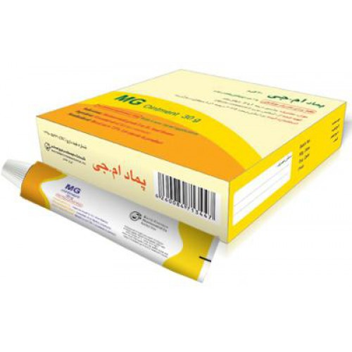
Production capacity
20000 Packages (Per 35 Days)
MG Topical Ointment
After sale services/ Guarantee
Indications: symptoms of hemorrhoid (haemorrhoid) Grade I and II, such as bleeding, pain, itching, burning and heavy anus and tenesmus (tenesmus; anal fissure (Annal fissure)
Dosage form and packaging: Ointment in tube - 30 gr
Composition: Myrtle Essential Oil
Administration and Dosage: Apply twice a day in the rectum. Apply one applicator each time. Counter-indications: No counter-indication is known for M.G ointment
Not applicable
Standards and legally certificates:
Local (Iran) Certificates
Sales’ Price
6.22 USD

Slide 37
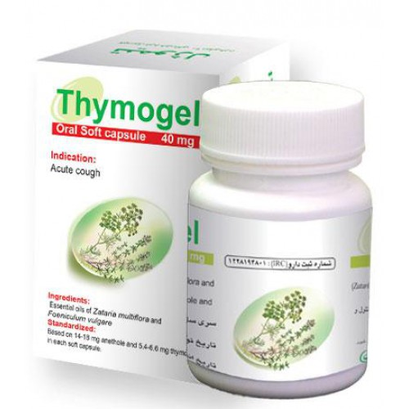
Production capacity
20000 Packages (Per 35 Days)
Thymogel Soft Capsule
After sale services/ Guarantee
Not applicable
Indications: Adjuvant treatment for acute cough
Dosage form and packaging: 30 Soft capsule - 40 mg
Composition: Sweet fennel (Foeniculum vulgare); Iranian thyme (Zataria multiflora)
Administration: Every 8 hours, take 1 Thymogel Oral Soft Capsule with a glass of lukewarm
Standards and legally certificates:
Local (Iran) Certificates
Sales’ Price
2.85 USD

Slide 38
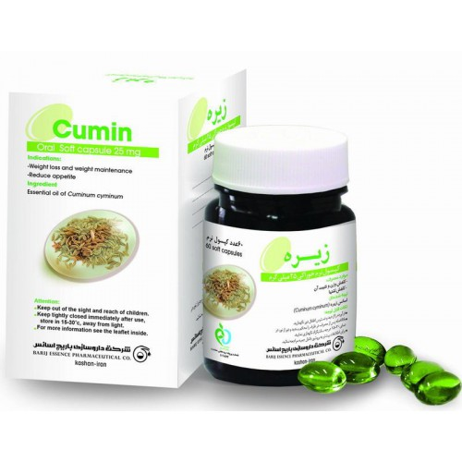
Production capacity
20000 Packages (Per 35 Days)
Cumin 75 Soft Capsule
After sale services/ Guarantee
Not applicable
Indications: Weight loss and weight maintenance; Reduction of appetite
Dosage form and packaging: 60 Soft capsule - 25 mg
Composition: Cumin essential oil
Administration: 3 times a day, every time a soft capsule should be taken with some liquids before meals.
Standards and legally certificates:
Local (Iran) Certificates
Sales’ Price
4.35 USD

Slide 39
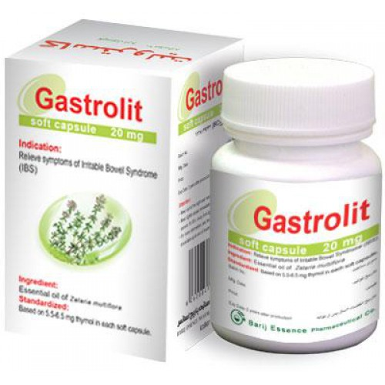
Production capacity
20000 Packages (Per 35 Days)
Gastrolit Soft Capsule
After sale services/ Guarantee
Not applicable
Indications: Adjuvant treatment for Irritable Bowel Syndrome (IBS) symptoms including pain, flatulence, heartburn, GERD and changes in stool consistency.
Dosage form and packaging: 30 Soft Capsule - 20 mg
Composition: Essential Oil of Zataria Multiflora
Standards and legally certificates:
Local (Iran) Certificates
Sales’ Price
2.85 USD

Slide 40
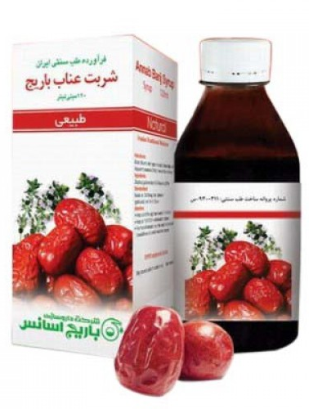
Production capacity
20000 Packages (Per 35 Days)
Annab Syrup
After sale services/ Guarantee
Not applicable
Indications: Blood diluents; Anti hyperviscosity; Blood depuration (Adjuvant Treatment of Metabolic Syndrome)
Dosage form and packaging: Syrup - 120 ml
Composition : Ziziphus jujuba; Zataria multiflora
Administration: Take 2 table spoon full every 8 hours
Standards and legally certificates:
Local (Iran) Certificates
Sales’ Price
3.8 USD

Slide 41
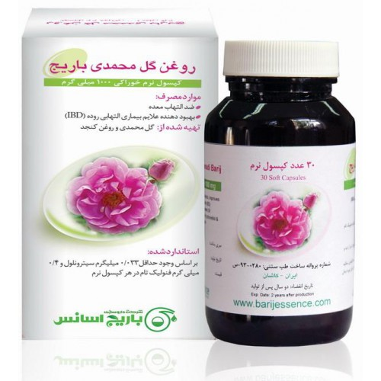
Production capacity
20000 Packages (Per 35 Days)
Roghan Gol Mohamadi Soft Capsule
After sale services/ Guarantee
Not applicable
Indications: Anti-inflammation of Stomach; Improving Symptoms of Inflammatory Bowel Disease (IBD)
Dosage form and packaging: 30 Soft capsule - 1000 m
Administration: Inflammation of Stomach: Three times a day, each time 1 pieces, half an hour before meal; Gastroesophageal Reflux: Three times a day, each time 2 pieces, half an hour before meal; Inflammatory Bowel Disease: Three times a day, each time 2 pieces, half an hour before meal.
Standards and legally certificates:
Local (Iran) Certificates
Sales’ Price
2.85 USD

Slide 42
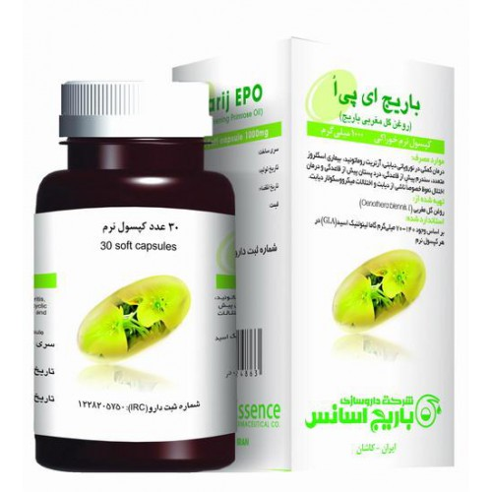
Production capacity
20000 Packages (Per 35 Days)
EPO Soft Capsule
After sale services/ Guarantee
Indications: Diabetic neuropathy; Rheumatoid arthritis; Multiple Sclerosis (MS); Premenstrual Syndrome (PMS) and premenstrual breast tenderness; Erectile dysfunction, especially caused by diabetes and microvascular abnormalities in diabetes.
Dosage form and packaging: 30 Soft capsules - 1000 mg
Composition: Evening Primrose Oil
Administration: Twice a day, 1-2 soft capsules each time; or as prescribed by your physician.
Not applicable
Standards and legally certificates:
Local (Iran) Certificates
Sales’ Price
7.36 USD

Slide 43

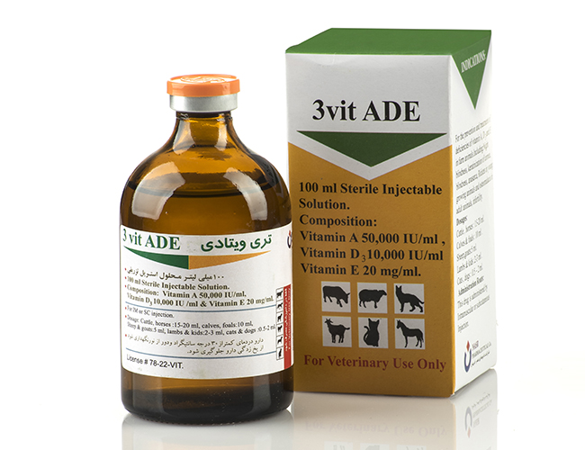
Production capacity
Nasr
2700-4200 Vials (Per Hour)
3 Vit ADE
Combination of 3 Vitamins A, D3 and E
To provide an immediately – available additional supply of the vitamin A, D3 and E when the diet Contains insufficient of these vitamins to satisfy requirements.
For the prevention and treatment of deficiencies of vitamin A, D3 and E in farm animals. Including:
Night Blindness
Keratinization of Cornea, blindness
Anasarca
Rickets in young growing animals
Osteomalacia in adult animals Infertility
After sale services/ Guarantee
Not applicable
Standards and legally certificates:
Local (Iran) Certificates
Sales’ Price
1.69 USD

Slide 44

Production capacity
Nasr
9000 Vials (Per Hour)
Penemix 2+1+1
After sale services/ Guarantee
Combination of three types of penicillins:
Penicillin G Benzathine
Penicillin G Procaine
Penicillin G Potassium
Penemix is used For the treatment of infections Caused by bacteria Sensitive to penicillin, in horses, Cattle, Sheep, dogs and cats, where long acting therapy is required.
Not applicable
Standards and legally certificates:
Local (Iran) Certificates
Sales’ Price
0.42 USD

Slide 45

Production capacity
Nasr
2700-4200 Vials (Per Hour)
Cyanoferin
After sale services/ Guarantee
Combination of Iron (in a dextran complex) and Cyanocobalamin (Vit B12).
For the prophylaxis and treatment of iron deficiency anemia, blood loss and other problems of haemopoesis.
For the treatment of debility, inappetence and general unthriftiness. Also in convalescence and in metabolic conditions such as acetonemia and pregnancy toxemia
Not applicable
Standards and legally certificates:
Local (Iran) Certificates
Sales’ Price
1.15 USD

Slide 46

Production capacity
Nasr
2400 Vials (Per Hour)
Calcibor40
After sale services/ Guarantee
Not applicable
Combination of 3 Calcium Gluconate and Boric Acid
Used for the prevention and the treatment of rickets in young growing animals and osteomalacia in adult animals.
This drug also is used for the treatment of hypocalcaemia in cattle, sheep, and in eclampsia horses.
Standards and legally certificates:
Local (Iran) Certificates
Sales’ Price
1.74 USD

Slide 47

Production capacity
Nasr
2500 Vials (Per Hour)
Ceftiprin 1
After sale services/ Guarantee
Not applicable
Ceftiprin1 is a broad spectrum cephalosporin antibiotic active against Gram-positive and Gram-negative bacteria including β-lactamase-producing strains.
Ceftiprin1 used for the treatment of bovine respiratory disease and acute bovine interdigital necrobacillosis.
For treatment of:
horse respiratory infections
swine bacterial respiratory disease
sheep respiratory disease
canine urinary tract infections.
Standards and legally certificates:
Local (Iran) Certificates
Sales’ Price
1.15 USD

Slide 48


Production capacity
20000 Vials (Per Month)
After sale services/ Guarantee
Teicomix®
Not applicable
Antimicrobial medicine for treatment of serious infection caused by resistant microbes (MRSA)
Standards and legally certificates:
Local (Iran) Certificates
Sales’ Price
7.4 USD

Slide 49


Production capacity
20000 Packages (Per 35 Days)
Methadone 5, 20 , 40mg
After sale services/ Guarantee
Not applicable
Methadone is an Opioid agonist
Indication:
drug withdrawal syndrome,
opioid type drug dependence,
moderate to severe pain relief.
Dosage: 3 dose of Methadone 5, 20 and 40 mg as Oral Tablets and 25mg/5ml as Oral solution.
Standards and legally certificates:
Local (Iran) Certificates
Sales’ Price
Market Price

Slide 50

Production capacity
20000 Packages (Per 35 Days)
Noscough® Syrup: 100ml
After sale services/ Guarantee
Not applicable
Noscapine is a benzylisoquinoline alkaloid from plants of the poppy family. It acts as a cough suppressant.
Indication:
Irritant dry and allergic cough
Spasmodic cough
Bronchitis
Tracheitis
Viral infections of the upper respiratory tract
Pertussis (Whooping cough)
Dosage: 15 ml/h
Each 5ml contains: Noscapine 7 mg
Standards and legally certificates:
Local (Iran) Certificates
Sales’ Price
Market Price

Slide 51

Production capacity
20000 Packages (Per 35 Days)
Farantan® 125 (Bosentan)
After sale services/ Guarantee
It is a dual endothelin receptor antagonist used in the treatment of pulmonary artery hypertension (PAH).
It is licensed in United States, European Union and other countries by Actelion Pharmaceuticals for management of PAH under the trade name Tracleer.
Indication:
Treatment of pulmonary hypertension (WHO Group I), in patients with WHO Class II-IV symptoms
Reducing the number of new digital ulcers in patients with systemic sclerosis
Dosage: 62.5mg PO twice a day (4days)
Not applicable
Standards and legally certificates:
Local (Iran) Certificates
Sales’ Price
Market Price

Slide 52

Production capacity
20000 Packages (Per 35 Days)
Buprenorphine 0.4, 2, 8mg
After sale services/ Guarantee
Not applicable
It is an Agonist-Antagonist Opioid analgesic that displays high binding affinity but low intrinsic activity at the µ receptor.
It is used as an analgesic.
Indication:
Treatment of Opioid dependence and control of moderate to severe pain.
It can antagonize the action of more potent µ agonists such as morphine
Dosage: 0.2-0.4mg every 6-8 hours
Standards and legally certificates:
Local (Iran) Certificates
Sales’ Price
Market Price

Slide 53



Production capacity
1,352,727 Packages (Per Month)
Rolexan®
After sale services/ Guarantee
N/A
Anti coagolant
2000 – 4000 – 6000 - 8000
Enoxaparin sodium is a low molecular weight heparin marketed under the trade names ROLEXAN, among others.
It is an anticoagulant used to prevent deep vein thrombosis (DVT) or to treat acute deep vein thrombosis with or without pulmonary embolism (PE).
It is given as an injection just under the skin or intravenously.
Its use is evolving in acute coronary syndromes (ACS).
Standards and legally certificates:
GMP
CPP
FSC
Sales’ Price
4 – 6 – 10 – 12 USD

Slide 54


Production capacity
2,125,714 Packages (Per Month)
Glamer®
After sale services/ Guarantee
N/A
Treatment of multiple Sclerosis
20 – 40
Glatiramer acetate is an immuno-modulator drug currently used to treat multiple sclerosis and approved by the Food and Drug Administration (FDA) for reducing the frequency of relapses, but not for reducing the progression of disability.
Standards and legally certificates:
GMP
CPP
FSC
Sales’ Price
8.5 - 17 USD

Slide 55

Production capacity
2,125,714 Packages (Per Month)
ZOLENA®
After sale services/ Guarantee
N/A
Anti Cancer
Zoledronic acid (Reclast) is used to prevent or treat osteoporosis and Paget’s disease of bone and also high levels of calcium in the blood that caused by certain types of cancer.
It works by slowing bone breakdown, increasing bone density (thickness), and decreasing the amount of calcium released from the bones into the blood.
Standards and legally certificates:
GMP
CPP
FSC
Sales’ Price
40.0 USD

Slide 56

Production capacity
1,240,000 Packages (Per Month)
Desfonak®
After sale services/ Guarantee
N/A
Iron Chelating Agent
Desfonak, deferoxamine mesylate USP, is an iron-chelating agent, available in vials for intramuscular, subcutaneous, and intravenous administration.
Desfonak is supplied as vials containing 500 mg and 2 g of deferoxamine mesylate USP in sterile, lyophilized form.
Standards and legally certificates:
GMP
CPP
FSC
Sales’ Price
3.2 USD

Slide 57

Production capacity
913,091 Packages (Per Month)
Pepticare®
After sale services/ Guarantee
N/A
Proton pomp inhibitor
Pantoprazole sodium is a white to off-white crystalline powder and is racemic.
Pantoprazole has weakly basic and acidic properties.
Standards and legally certificates:
GMP
CPP
FSC
Sales’ Price
3.9 USD

Slide 58


Production capacity
20000 Packages (Per 35 Days)
URTICA EXTRACT
After sale services/ Guarantee
Not applicable
Indications: Kidney Stone Treatment; Complementary treatment for UTI
Dosage form and packaging: Syrup - 250 ml
Composition: Urtica dioica
Administration and Dosage: Twice a day, take one tablespoon (5 ml) after meals..
Standards and legally certificates:
Local (Iran) Certificates
Sales’ Price
11.3 USD

Slide 59

Production capacity
20000 Packages (Per 35 Days)
HYPERICUM EXTRACT SYRUP
After sale services/ Guarantee
Not applicable
Indications: Complementary treatment for peptic ulcers
Dosage form and packaging: Syrup - 120 ml
Composition: Hypericum perforatum
Administration and Dosage: Twice a day take one spoon before breakfast and at night before sleeping.
Standards and legally certificates:
Local (Iran) Certificates
Sales’ Price
7.4 USD

Slide 60

Production capacity
20000 Packages (Per 35 Days)
SAFFRON EXTRACT ORAL DROP
After sale services/ Guarantee
Not applicable
Indications: Anti-depressants; Premenstrual Syndrome (PMS); Help prevent cancer; Sexual enhancer
Dosage form and packaging: Oral drop - 15 ml
Composition: Crocus sativus
Administration and Dosage: Daily 3 times, each time 3 to 5 drops solve in a glass of water or juice.
Standards and legally certificates:
Local (Iran) Certificates
Sales’ Price
7.14 USD

Slide 61

Production capacity
20000 Packages (Per 35 Days)
ROSEMARY ESSENTIAL OIL SPRAY
After sale services/ Guarantee
Not applicable
Indications: Rheumatoid arthritis treatment
Dosage form and packaging: Spray - 120ml
Composition: Rosmarinus officinalis
Administration and Dosage: Spray 2 puffs of Rosemary 3 to 4 times a day on affected area, massage till completely absorb.
Standards and legally certificates:
Local (Iran) Certificates
Sales’ Price
4.27 USD

Slide 62

Production capacity
20000 Packages (Per 35 Days)
THYME ESSENTIAL OIL SPRAY
After sale services/ Guarantee
Not applicable
Indications: Anti-aphthous
Dosage form and packaging: Spray - 50 ml
Composition: Thymus vulgaris
Administration and Dosage: Spray in the mouth several times a day.
Use of this extract is recommended to complete resolution of symptoms
Standards and legally certificates:
Local (Iran) Certificates
Sales’ Price
2.28 USD

Slide 63

Production capacity
20000 Packages (Per 35 Days)
Flaxseed ZB Herbal powder
After sale services/ Guarantee
Not applicable
Indications: Laxative & Treatment for constipation
Dosage form and packaging: powder - 72 gr
Composition: Flaxseed
Administration and Dosage: Three times a day, mix one sachet with a glass of water and take it before meal.
Standards and legally certificates:
Local (Iran) Certificates
Sales’ Price
2.00 USD

Slide 64

Production capacity
20000 Packages (Per 35 Days)
Dill TS Herbal oral drop
After sale services/ Guarantee
Not applicable
Indications: Reduces cholesterol
Diseases: Hyperlipidemia
Dosage form and packaging: Oral Drop – 15ml
Composition: 100% natural essential oil, functions as a hypolipidemic (lipid-lowering) herbal medicine. It is gained from "Anethum graveolens"
Administration and Dosage: Three times a day, mix 3 to 5 drops in a cup of water or juice, and .drink
Standards and legally certificates:
Local (Iran) Certificates
Sales’ Price
1.88 USD

Slide 65
Cosmetic Products

Slide 66


Production capacity
70000 Packages (Per Month)
High Protection Multilayer Sunscreen Cream
After sale services/ Guarantee
Not applicable
Age Protect SPF 60
High performance UVB/UVA protection
Restores moisture and prevents sunburn
Contains α-bisabolol to prevent skin redness
Enriched with Vitamin E
Standards and legally certificates:
Local (Iran) Certificates
Sales’ Price
6.5 USD

Slide 67

Production capacity
25000 Packages (Per Month)
Skin Relief & Repair Cream
After sale services/ Guarantee
Not applicable
Enriched with Copper & Zinc
Helps reduce the appearance of burns, cuts and scars following surgery
Suitable for use on both old and new scars
Scars appear smoother and less noticeable
Penetrates skin to repair damaged tissues and stimulate collagen production
Soothes dry skin, reduces itchiness and alleviates discomfort
Standards and legally certificates:
Local (Iran) Certificates
Sales’ Price
5.5 USD

Slide 68

Production capacity
50000 Packages (Per Month)
Age-Resisting Foundation
After sale services/ Guarantee
Not applicable
SPF 30
Hides imperfections, evens out skin tone and creates a soft natural finish that lasts all day.
Visibly delays the appearance of fine lines, reduces wrinkles and gives the skin a firmer look.
Oil free with no synthetic dyes.
Medium/full coverage.
Non-acnegenic and non-comedogenic
Standards and legally certificates:
Local (Iran) Certificates
Sales’ Price
7.5 USD

Slide 69

Production capacity
70000 Packages (Per Month)
High Protection
Tinted Sunscreen Cream
After sale services/ Guarantee
Not applicable
SPF 50
Contains vital anti-oxidants to help protect against free radicals, premature ageing and UVA induced photo-ageing
Oil free lightweight formula for optimum protection
Contains a light tint for an even skin tone and matte finish
Standards and legally certificates:
Local (Iran) Certificates
Sales’ Price
7.0 USD

Slide 70

Production capacity
60000 Packages (Per Month)
Active Sunscreen Cream
After sale services/ Guarantee
Not applicable
SPF 50
Non comedogenic
Ultra-light non-greasy formula
Moisturizes and protects against sun exposure and extreme weather conditions
Helps strengthen skin and prevent premature ageing
Provides broad spectrum protection (UVA/UVB)
Standards and legally certificates:
Local (Iran) Certificates
Sales’ Price
5.5 USD

Slide 71


Production capacity
50000 Packages (Per Month)
Natural Cover Foundation
After sale services/ Guarantee
Lightweight formula builds evenly bestowing radiance and coverage for a natural or full finish look.
Blendable texture of this foundation helps effortless application.
Radiance: intense luminous glow - Flawless Spreadability
Coverage: from natural-looking to bolder and fuller coverage - Perfect even Finish
Hydration: - light and blendable texture for a fresh looking glow - Matte Finish
Colors: Vanilla Cream, Bronze, Ivory, Peach, Creamy Coral & Dark Beige
Not applicable
Standards and legally certificates:
Local (Iran) Certificates
Sales’ Price
10.0 USD

Slide 72


Production capacity
20000 Packages (Per 35 Days)
ANTI-BACTERIAL & ANTI-PLAQUE TOOTHPASTE
After sale services/ Guarantee
Not applicable
Indications: Anti-Bacterial & Anti-Plaque
Dosage form and packaging: Cream - 120 gr
Composition: Savory; Cloves; Propolis; Eucalyptus
Standards and legally certificates:
Local (Iran) Certificates
Sales’ Price
1.8 USD

Slide 73

Production capacity
20000 Packages (Per 35 Days)
ANTI-PIGMENTATION CREAM
After sale services/ Guarantee
Not applicable
Indications: Ideal for Melasma and Pregnancy Freckles; Reduces Pigmentation Marks; Prevention of Sun Damage and Age Spots
Dosage form and packaging: Cream - 75 ml
Composition: Silymarin; Malva
Standards and legally certificates:
Local (Iran) Certificates
Sales’ Price
5.5 USD

Slide 74

Production capacity
20000 Packages (Per 35 Days)
FACIAL CLEANSING GEL
After sale services/ Guarantee
Not applicable
Indications: Face wash for oily, acne, sensitive and combination skins
Dosage form and packaging: Gel - 200 ml
Standards and legally certificates:
Local (Iran) Certificates
Sales’ Price
3.38 USD

Slide 75

Production capacity
20000 Packages (Per 35 Days)
HAIR COLOR PROTECTING SHAMPOO
After sale services/ Guarantee
Not applicable
Indications: Hair Color Protecting; Radiance Hair
Dosage form and packaging: Shampoo - 200 ml
Composition: Pomegranate; Carthamus; Tragacanth
Standards and legally certificates:
Local (Iran) Certificates
Sales’ Price
2.9 USD

Slide 76

Production capacity
20000 Packages (Per 35 Days)
HERBAL REPAIR CREAM
After sale services/ Guarantee
Not applicable
Indications: Natural Remedy for Skin Rashes & Eczema
Dosage form and packaging: Cream - 60 ml
Composition: Calendula; Olive oil; Natural Honey
Standards and legally certificates:
Local (Iran) Certificates
Sales’ Price
3.24 USD

Slide 77

Production capacity
20000 Packages (Per 35 Days)
LIGHTENING CREAM
After sale services/ Guarantee
Not applicable
Indications: Anti-oxidant; Moisturizing; Reduce skin dryness and wrinkles
Dosage form and packaging: Cream - 60 ml
Composition: Licorice; Green tea
Standards and legally certificates:
Local (Iran) Certificates
Sales’ Price
3.33 USD

Slide 78

Production capacity
20000 Packages (Per 35 Days)
SUNSCREEN GEL SPF 40
After sale services/ Guarantee
Not applicable
Indications: Sunscreen for oily and acne prone skin
Dosage form and packaging: Gel - 60 ml
Composition: Calendula; Green tea; Cinnamon
Standards and legally certificates:
Local (Iran) Certificates
Sales’ Price
3.24 USD

Slide 79
Industrials

Slide 80


Production capacity
3 – 5 Projects (Per year)
KTC-DCS
After sale services/ Guarantee
84 months after sale services
12 months Guarantee
It has a flexible structure that can be used as DCS, PMS, SCS, etc.
Any failure in one of the network cables, switches or cards has no effect in full functioning of the system.
Hardware is a modular system based on IEEE-1014(VME) which is an industrial computer that includes CPU, IO and communication modules.
Use for controling systems in:
Oil & Gas and Petrochemical industry, Mine and metal, Water and Construction Industries, Power (Generation, Transmission, Distribution), Railway, etc.
Standards and legally certificates:
CE
IEC61000 , IEC60068
Certificate of Security evaluation
Sales’ Price
250,000 $ - 12,000,000 $ (Depending on Project Scale)

Slide 81
Production capacity
3 – 5 Projects (Per year)
KTC-SCADA
After sale services/ Guarantee
84 months after sale services
12 months Guarantee
It is a powerful, flexible, distributed Supervisory Control and Data Acquisition (SCADA) system.
This package provides organizations with critical information, enabling them to improve their overall business performance.
Full modular, preventing of total failure at failure of a specific module
Use for controling systems in:
Oil & Gas and Petrochemical industry, Mine and metal, Water and Construction Industries, Power (Generation, Transmission, Distribution), Railway, etc.
Standards and legally certificates:
OHSAS 18001:2007
ISO 9001: 2008, ISO 14001:2008
HSE-MS HSE
Sales’ Price
450,000 $ - 36,000,000 $ (Depending on Project Scale)

Slide 82


Production capacity
3000 Units (Per Month)
Smart Electromagnetic water meter (Easy Mag800)
After sale services/ Guarantee
120 months after sale services
36 months Guarantee
Applicable to agricultural wells, diesel pumps, and gravity currents
Based on measurement of the amount of passing water with accuracy of 0.5%
No moving mechanical parts in the way of water flow
On site easy and fast repair (modular)
Impossible to contravene and manipulate
Without fragile pieces
Sealed in order to protect the meter from being removed
Seamless cast iron body which requires neither input electricity nor any protectors
Capable of operating with an internal Li-ion battery for 3 years
Standards and legally certificates:
Final Confirmation from Iran Ministry of Energy
Sales’ Price
1400 – 2250 $ (Depends on Size)

Slide 83



Production capacity
3500 ton (Per month)
HARD
CARBON BLACK:
After sale services/ Guarantee
12 months Guarantee
Gives high wear-resistance, high resistance to rupture, tear resistance to rubber, high dynamic hardness and elastic rebound to rubber, high durability, and low hysteresis
Widely used for producing: high quality, protecting rubbers and protecting stocks, transporter and conveyor belts, breaker rubber, technical seals, cable covers. It is also used for producing high quality rubber molded articles working in hard conditions.
Standards and legally certificates:
IMS
ISO9001_2008 , ISO14001_2004
ISO18001_2007
Sales’ Price
With Negotiation

Slide 84


Production capacity
3500 ton (Per month)
SOFT
CARBON BLACK:
After sale services/ Guarantee
12 months Guarantee
Gives high elasticity to rubber, middle hardness
Has high ability for filing, high profiling properties
Widely used for producing: tires, tubes, sleeves, profiling articles, technical seals, molded articles, roof coverings, framed and breaker rubbers, cables, footwear
Standards and legally certificates:
IMS
ISO9001_2008 , ISO14001_2004
ISO18001_2007
Sales’ Price
With Negotiation

Slide 85


Production capacity
10 Sets (Per Month)
SHOLEH SANAT co
Cement and Lime Rotary Kilns Burner
After sale services/ Guarantee
???
Model: CKG(O)
Fuel: Gas, Heavy Oil
Application: Cement and Lime Rotary Kilns
Turn-Down Ratio: 4:1
Maximum Heat Capacity: 170,000,000 kCal/hr
Standards and legally certificates:
Local (Iran) Certificates
Sales’ Price
50000 – 100000 $

Slide 86


Production capacity
50 Sets (Per Month)
SHOLEH SANAT co
Medium Velocity Burner for Fired Heaters
After sale services/ Guarantee
???
Model: NGOF/R/S
Fuel: Gas, Liq
Application: Fired Heaters
Turn-Down Ratio: 5:1
Heat Capacity: 100,000 to 5,000,000 kCal/hr
Installation: Floor, Roof & Side
Standards and legally certificates:
Local (Iran) Certificates
Sales’ Price
It depends on burner installation position and capacity.

Slide 87

Production capacity
10 Sets (Per Month)
SHOLEH SANAT co
Precalciner Burner
After sale services/ Guarantee
???
Model: PCG(O)
Fuel: Gas, Heavy Oil
Application: Pre-Heating of Cement Kilns and Precalciner
Turn-Down Ratio: 4:1
Maximum Heat Capacity: 25,000,000 kCal/hr
Standards and legally certificates:
Local (Iran) Certificates
Sales’ Price
10000 – 20000 $

Slide 88


Fars EOR Tech
Production capacity
1 Device (Per Month)
Pendant Drop Contact Angle and IFT Measurement
After sale services/ Guarantee
120 months after sale services
12 months Guarantee
IFT range: 3-72 mN/m
Contact angle range: 5o-179o
Working pressure: Ambient
Maximum working temperature: 50 °C
Automatic control of moving parts (back light, visual cell and needle)
Automatic dosing pump ×1
Glass visual cell
CCD camera: 4 megapixel
Macro lens: Computar (C mount, magnification of 10×)
3 degree of freedom camera positioner×1
Back light×1
Online special software for analyzing the shape of the drop for measuring the IFT and contact angle of the liquid-liquid systems
Standards and legally certificates:
Local (Iran) Certificates
Sales’ Price
24100 $

Slide 89

Fars EOR Tech
Production capacity
1 Device (Per Month)
HP-HT Pendant Drop IFT Measurement
After sale services/ Guarantee
120 months after sale services
12 months Guarantee
IFT range: 1-72 mN.m-1
Maximum working pressure: 700 bar
Pressure transmitter×1
Pressure accuracy: 0.25 % full scale
Maximum working temperature: 150 °C
Temperature resolution: ±0.1 °C
High pressure cell equipped with 2 HP sight glasses
High pressure manual pump×2
CCD camera: 4 megapixel - Macro lens: Computar (C mount, magnification of 10×)
Four degree of freedom camera positioner×1
Back light×1
Online drop shape analysis software
Standards and legally certificates:
Local (Iran) Certificates
Sales’ Price
46400 $

Slide 90

Fars EOR Tech
Production capacity
1 Device (Per Month)
HP-HT Pendant Drop IFT Measurement
After sale services/ Guarantee
120 months after sale services
12 months Guarantee
IFT range: 1-72 mN.m-1
Maximum working pressure: 700 bar
Pressure transmitter×1
Pressure accuracy: 0.25 % full scale
Maximum working temperature: 150 °C
Temperature resolution: ±0.1 °C
High pressure cell equipped with 2 HP sight glasses
High pressure manual pump×2
CCD camera: 4 megapixel
Macro lens: Computar (C mount, magnification of 10×)
4 degree of freedom camera positioner×1
Back light×1
Online drop shape analysis software
Standards and legally certificates:
Local (Iran) Certificates
Sales’ Price
67700 $

Slide 91

Fars EOR Tech
Production capacity
1 Device (Per Month)
Core Acidizing
Hassler core holder×2
Core diameter: 1.5” - Maximum core length: 6”
Maximum working & injection pressure: 700 bar
Pressure transmitter×4
Differential pressure transmitter×2
Gas back pressure regulator×2: 700bar
Maximum working temperature: 100 °C
Heating system: Thermal jacket
Fluid accumulator×2: 750cc Hastelloy C-276
Fluid accumulator×1: 750cc Stainless steel 316L
Asymmetric design to perform two parallel acid injections into different cores - Cylinder volume: 500 cc
Equipped with manual rocking system for core holder rotation at 90, 180, 270 and 360 degrees
Vertical, horizontal and reverse injection of fluid
Computer system: Equipped with software for automatic data acquisition and monitoring system
Constant pressure and flow rate mode - Pulseless injection
After sale services/ Guarantee
120 months after sale services
12 months Guarantee
Standards and legally certificates:
Local (Iran) Certificates
Sales’ Price
152000 $

Slide 92

Fars EOR Tech
Production capacity
1 Device (Per Month)
General Core Flooding
Hassler core holder×1 - Core diameter: 1.5”
Maximum core length: 3.5”
Maximum working pressure: 700 bar
Maximum confining pressure: 700 bar
Pressure transmitter×2
Differential pressure transmitter×3
Gas back pressure regulator×1: 700 bar
Maximum working temperature: 150°C
Temperature resolution: ±1°C
Oven: 600 liters - Volume: 4 liters
Fluid accumulator×3: 750 cc
Miniature fluid accumulator×1: 100 cc for rinsing the system
Gasometer×1: Equipped with a linear encoder
Linear encode accuracy: 5 μm
Wetted parts: Stainless steel 316L
Software for automatic pressure and temperature recording
After sale services/ Guarantee
120 months after sale services
12 months Guarantee
Standards and legally certificates:
Local (Iran) Certificates
Sales’ Price
92200 $

Slide 93

Fars EOR Tech
Production capacity
1 Device (Per Month)
Wettability Alteration Chamber
After sale services/ Guarantee
120 months after sale services
12 months Guarantee
Maximum core diameter: 1.5"
Maximum working pressure: 400 bar
Maximum working temperature: 150 °C
Cell volume: 100, 300, 500 cc
High pressure cell×3
Pressure gauge×4
Heating system: Oven
Hydraulic pressurizing system
Wetted parts: Stainless steel 316L
Standards and legally certificates:
Local (Iran) Certificates
Sales’ Price
12400 $

Slide 94



Production capacity
3 Tanks (in 10 Months)
3*3,315 m³ (Per month)
After sale services/ Guarantee
EPC of Three Spherical Tanks
120 months after sale services
12 months Guarantee
LPG Storage tanks
QTY: 3
Capacity of each tank: 3300 m3
Dimensions: diameter of 18.5 m
Weight of each tank: 622 tons
Standards and legally certificates:
ASME Sec. VIII Div1 & Div2
ASME Sec I, II, …, XIII,
API 650 - API 620
IPS – ASTM ANSI, 8. DIN
Sales’ Price
1,950,000 $

Slide 95


Production capacity
2 Tanks (in 12 Months)
2*5,000 m³ (Per month)
After sale services/ Guarantee
EP of 2 Cylindrical Tanks
120 months after sale services
12 months Guarantee
Storage Tanks
QTY: 2
Capacity of each tank: 5300 m3
Tank type: fixed roof
Dimensions: diameter of 20 m and height of 17 m
Weight of each tank: 170 tons
Standards and legally certificates:
ASME Sec. VIII Div1 & Div2
ASME Sec I, II, …, XIII,
API 650 - API 620
IPS – ASTM ANSI, 8. DIN
Sales’ Price
1,950,000 $

Slide 96

Production capacity
1 Project (Per 2 years)
After sale services/ Guarantee
Precommissioning
120 months after sale services
12 months Guarantee
Installation of the hydrants, fittings, valves, kits and other required equipment. Flashing and reinstating of underground pipelines in different sizes (more than 30 km) and their precommissioning.
Standards and legally certificates:
ASME Sec. VIII Div1 & Div2
ASME Sec I, II, …, XIII,
API 650 - API 620
IPS – ASTM ANSI, 8. DIN
Sales’ Price
100,000 $

Slide 97
Other Products

Slide 98









Production capacity
913,091 Packages (Per Month)
Pepticare®
After sale services/ Guarantee
N/A
Appearance & Texture Similar To Wood
Inflammable
Waterproof
Anti-mold & Peeling
Termite & Rodent Resistant
Recyclable
Installation, Easy Maintenance
Standards and legally certificates:
GMP
CPP
FSC
Sales’ Price
3.9 USD

Slide 99




Production capacity
50000 Packages (Per Month)
After sale services/ Guarantee
Not applicable
Herbal Tea Spoons
Peppermint Herbal Tea
Chamomile Herbal Tea
Galega Herbal Tea
16×2g
Standards and legally certificates:
Local (Iran) Certificates
Sales’ Price
4.0 USD

Slide 100


Production capacity
250000 Liter (Per Year)
After sale services/ Guarantee
Viva Q10®
120 months after sale services
36 months Guarantee
Animal (Hydrolysed fresh whole blood) & plant extract based natural fertilizer
Liquid Natural Fertilizer
Dark brwon color with sweet odor
Standards and legally certificates:
Local (Iran) Certificates
Sales’ Price
Bottle 1 Liter: 3 $
Bottle 5 Liter: 14 $

Slide 101

Production capacity
200000 Liter (Per Year)
After sale services/ Guarantee
Viva Q10®
120 months after sale services
36 months Guarantee
Plant (Hydrolysed Corn protein based natural fertilizer
Liquid Natural Fertilizer
Light brwon color with sweet odor
Standards and legally certificates:
Local (Iran) Certificates
Sales’ Price
Bottle 1 Liter: 3 $
Bottle 5 Liter: 14 $

Slide 102

Production capacity
400 Ton (Per Year)
After sale services/ Guarantee
Yield Booster®
120 months after sale services
36 months Guarantee
Animal (dried fresh whole blood) & mineral based natural fertilizer
Solid Natural Fertilizer,
Granular form, granule size is 2-4 mm (80 %)
Light blue color
Standards and legally certificates:
Local (Iran) Certificates
Sales’ Price
1.1 $ (Per Kg)

Slide 103


Production capacity
Unlimited
GoldNet AAA Software (GNAS)
After sale services/ Guarantee
120 months after sale services
12 months Guarantee
It covers all the features of a common AAA System along with customization capability we provide for our customers.
GNAS is compatible to the most known Remote Access Servers (RAS).
This system fulfills all technical requirements and controls service establishment in access layer.
GoldNet AAA system supports 500,000 concurrent online users which is deployed for major Middle East telecom companies and passed the relevant performance tests successfully.
GoldNet AAA solution has been integrated with Huawei, Cisco, MikroTik and ZTE RAS's.
Standards and legally certificates:
GNAS Technical Approval from High Council of Informatics
Sales’ Price
Depending on the customer's request, the price will be different.

Slide 104

Production capacity
1000 Devices (Per Month)
Tracker Device
After sale services/ Guarantee
120 months after sale services
12 months Guarantee
Useful for:
fleet management, transportation system
Railway and Building Industry
Organizational Fleet management
Mine Industry
Security and Peace by Tracking School Bus
Special solutions for refrigerated trucks - Tracking Heavy Weight Trucks
GoldNet tracker device is locally designed in Research and Development department of GoldNet, with Patent license .
Software access and management is Web-based and the device local design and implementation provide its hardware and software customization and personalization with the lowest service charge
Standards and legally certificates:
Approval from High Council of Informatics
Technical Approval from Communications Regulatory Authority of The I.R. of Iran
Software Operation license from Ministry of Industry, Mine and Trade
Sales’ Price
40 $

Slide 105
Thanks

